Slide 1




Next Gen Employability Program
Full Stack Web Development with AI Tools
Team Details – NG_CP_Team_794
Name: Rajan Kumar
Name: Awdhesh Kumar Das
Name: Mukesh Kumar
Name: Rajan
Name: Prabhakar Gautam
College: Meerut Institute Of Technology, Meerut

Slide 2

The content is curated from online/offline resources and used for educational purpose only.
Notes:
Speaker would be briefing the students that this content has been prepared for the educational purpose only and is referred from multiple sites which are cited in the last.​​
---------------------------------------------------​​
A disclaimer is a statement or notice that is intended to clarify, limit, or provide information about the scope, limitations, or potential risks associated with certain actions, information, products, services, or content. ​​
​​
​

Slide 3

Project Title
ONLINE BLOOD DONATION MANAGEMENT . SYSTEM.
Notes:
In this slide speaker will be introducing the program and its outcomes. The speaker will introduce himself in brief

Slide 4

Table of Contents
Introduction
Problem Statement
Proposed Solutions
Key features
Technology stack
System Flowchart
Core Modules
Conclusion & Future Work
References
Notes:
This slide, The speaker will talk about the content that we will be covering in this session as follows:
Introduction
Importance of UI/UX in industry
History and Definitions of UI and UX
Key Differences between UI/UX
Use Cases
Significance in Web Development
Use Cases
Visual Design Principles
Design process
Color theory and psychology
Typography and readability
Layout and Spacing
Responsive design basics
Usability and Accessibility
Usability Aspects
Web Content Accessibility Guidelines (WCAG)
Inclusive design practices
Consistency
User Experience
User-Centered Design
User research methods
Interactive Elements and Feedback
Mini Case Study
Discussing a popular UI/UX design
Hands-On
Introduction to Figma for UI/UX design

Slide 5

Introduction:
it helps to connect blood donors with people in need of blood
Blood availability is critical in healthcare.
Existing systems have fake inventory and delays.
OBDMS is a request-based blood donation system.
Connects donors, hospitals, and requesters.
Ensures donation only after a valid request.
Notes:
This slide, The speaker will talk about the content that we will be covering in this session as follows:
Introduction
Importance of UI/UX in industry
History and Definitions of UI and UX
Key Differences between UI/UX
Use Cases
Significance in Web Development
Use Cases
Visual Design Principles
Design process
Color theory and psychology
Typography and readability
Layout and Spacing
Responsive design basics
Usability and Accessibility
Usability Aspects
Web Content Accessibility Guidelines (WCAG)
Inclusive design practices
Consistency
User Experience
User-Centered Design
User research methods
Interactive Elements and Feedback
Mini Case Study
Discussing a popular UI/UX design
Hands-On
Introduction to Figma for UI/UX design

Slide 6
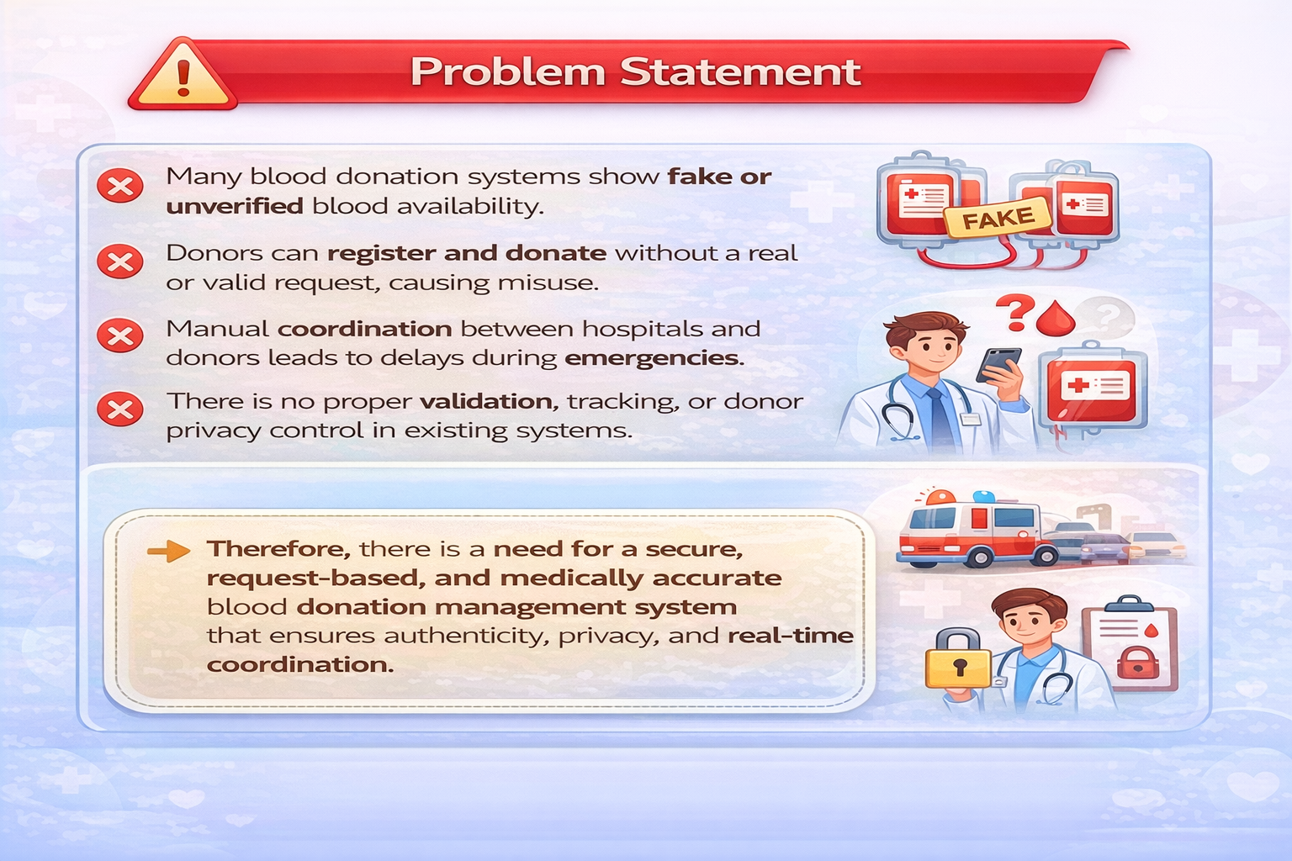
PROBLEM STATEMENT :
Fake blood availability in existing systems
Donations without real requests
Manual and delayed coordination
Unverified blood requests by blood banks.
Notes:
This slide, The speaker will talk about the content that we will be covering in this session as follows:
Introduction
Importance of UI/UX in industry
History and Definitions of UI and UX
Key Differences between UI/UX
Use Cases
Significance in Web Development
Use Cases
Visual Design Principles
Design process
Color theory and psychology
Typography and readability
Layout and Spacing
Responsive design basics
Usability and Accessibility
Usability Aspects
Web Content Accessibility Guidelines (WCAG)
Inclusive design practices
Consistency
User Experience
User-Centered Design
User research methods
Interactive Elements and Feedback
Mini Case Study
Discussing a popular UI/UX design
Hands-On
Introduction to Figma for UI/UX design

Slide 7
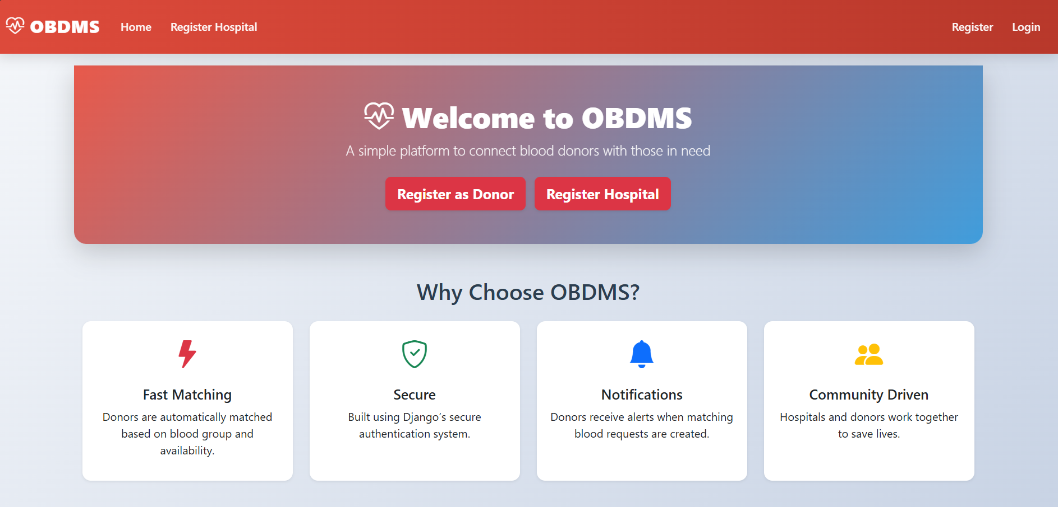
PROPOSED SOLUTION :
The OBDMS solves these issues by:
Allowing blood donation only after a valid blood request
Removing blood banks and inventory systems
Automatically matching donors using blood groups
Ensuring donor privacy until acceptance

Slide 8
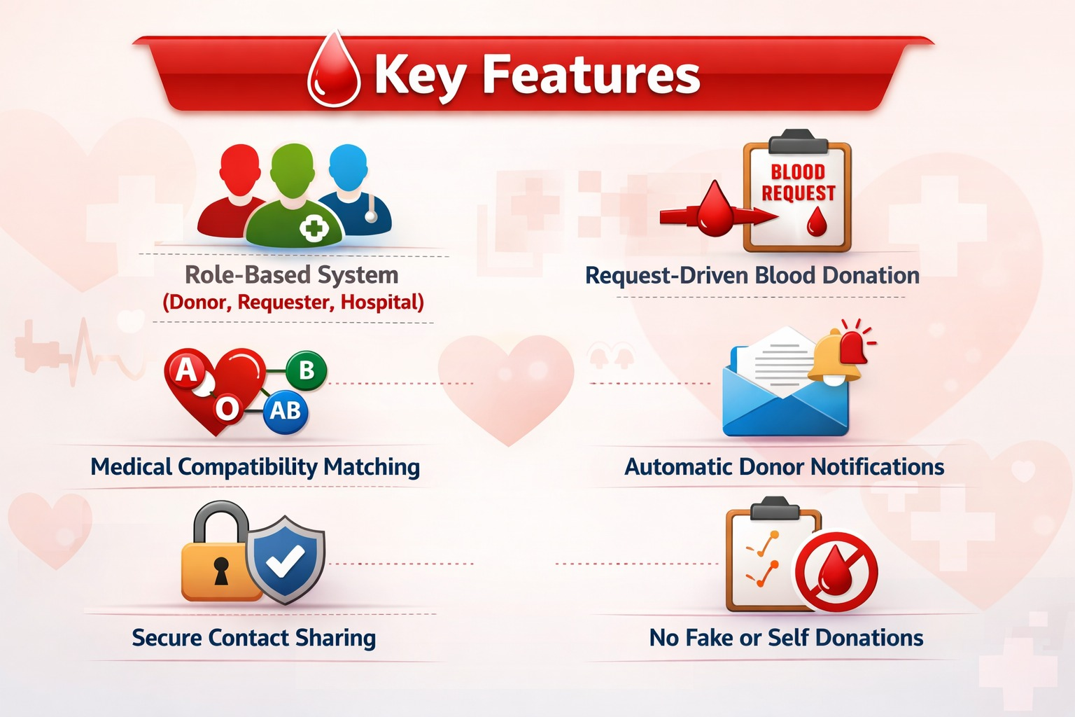
KEY FEATURES:
Role-based system (Donor, Hospital)
Request-based blood donation
No fake blood inventory
Medical blood compatibility matching
Automatic notifications
Secure contact sharing after donor acceptance

Slide 9
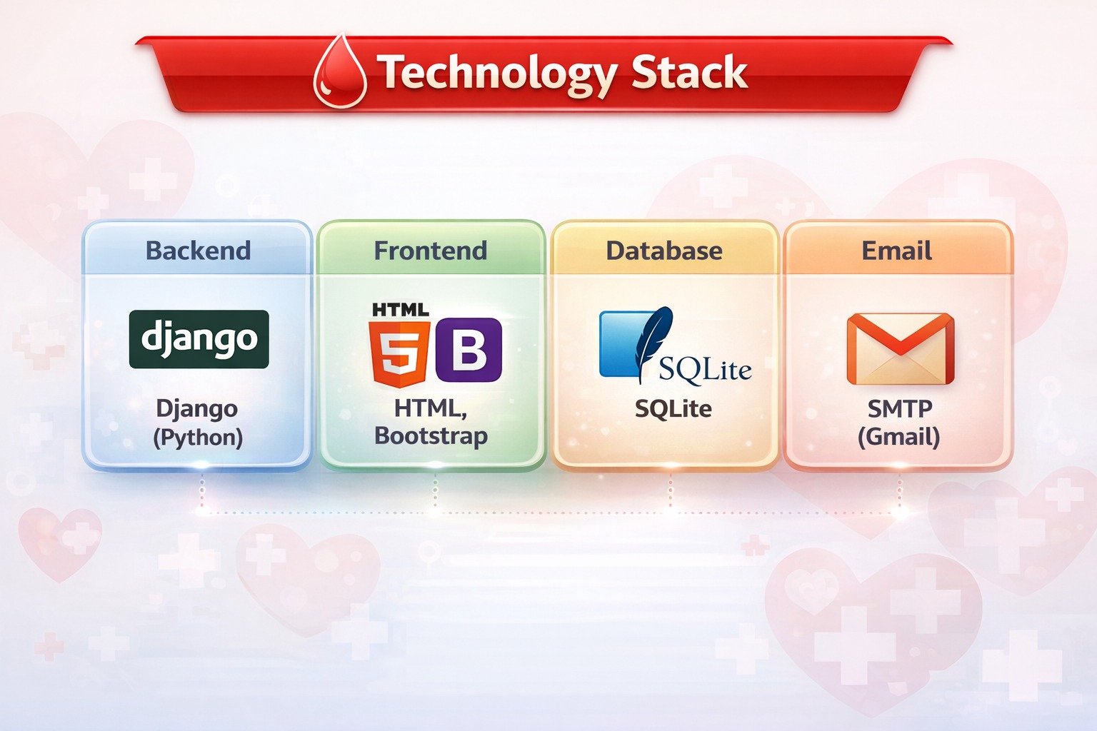
TECHNOLOGY USED :
Frontend:
HTML, CSS, BOOTSTRAP
Backend:
Python Django
Database:
SQLite3(db.sqllite3)
Email:
SMTP
Tools:
VS Code, Web Browser

Slide 10
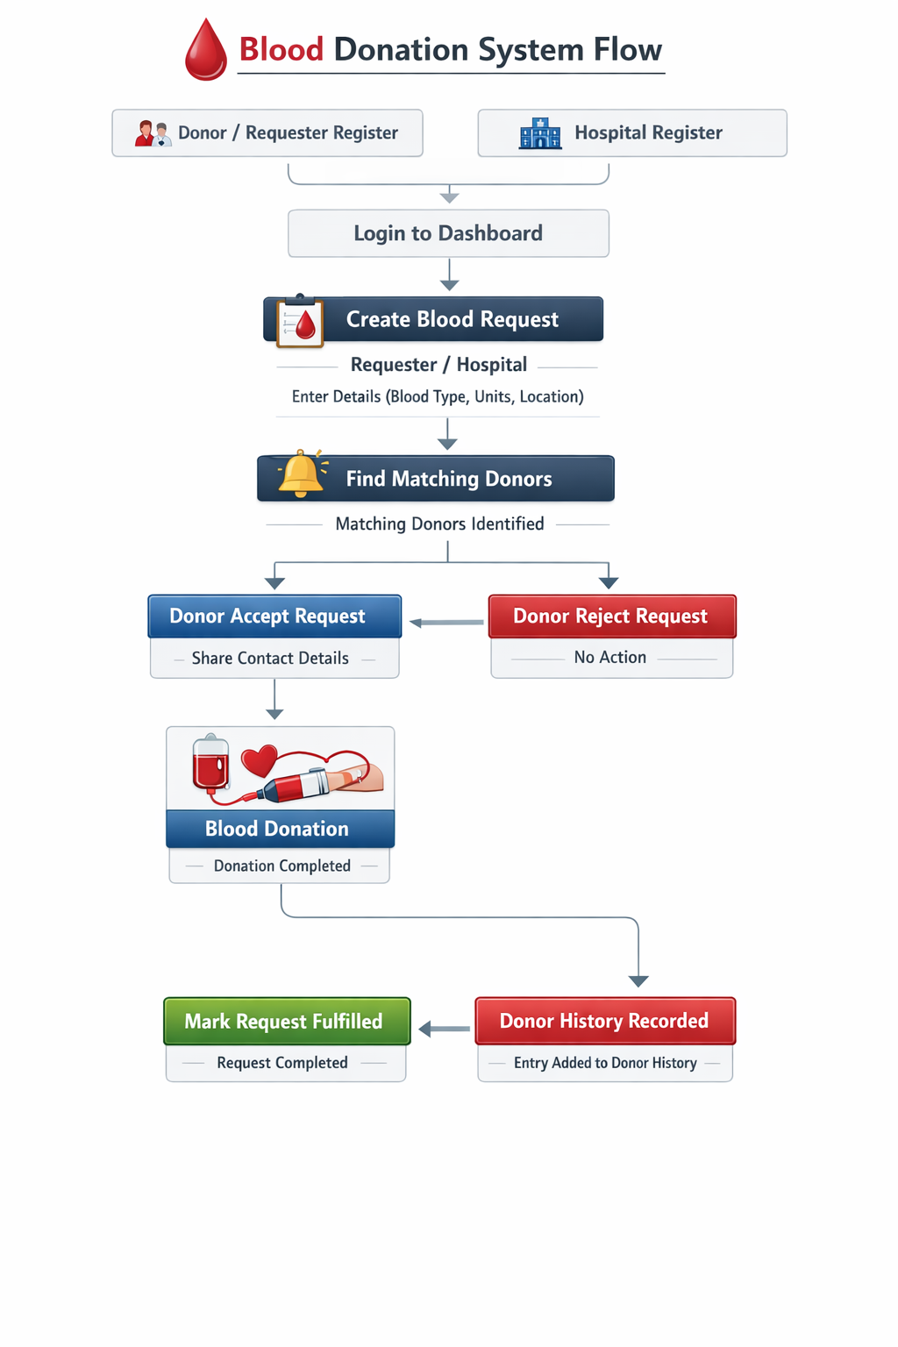
SYSTEM FLOWCHART :

Slide 11
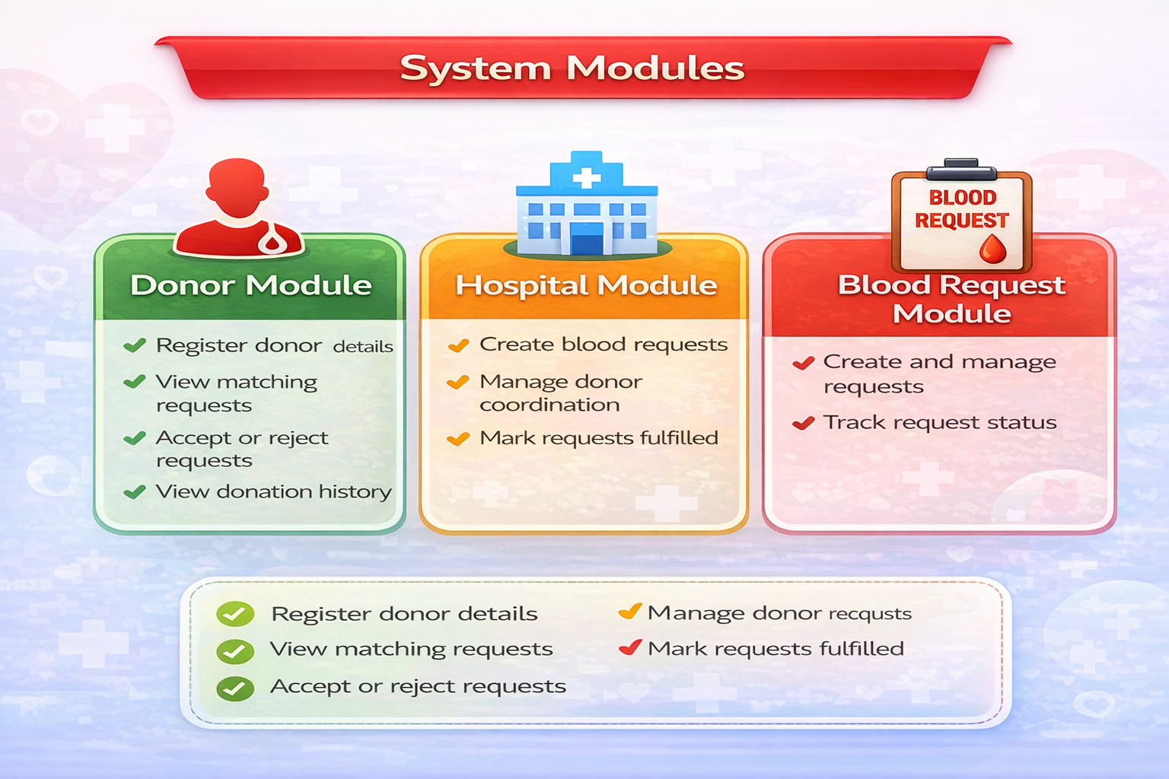
CORE MODULES :
1.Donor
Module Register/Login
View matching requests
Accept/Reject request
Record donation
3. Blood Request Module
Validate request
Match donors
Track status
2. Hospital Module
Register/Login
Create blood request
Manage requests

Slide 12
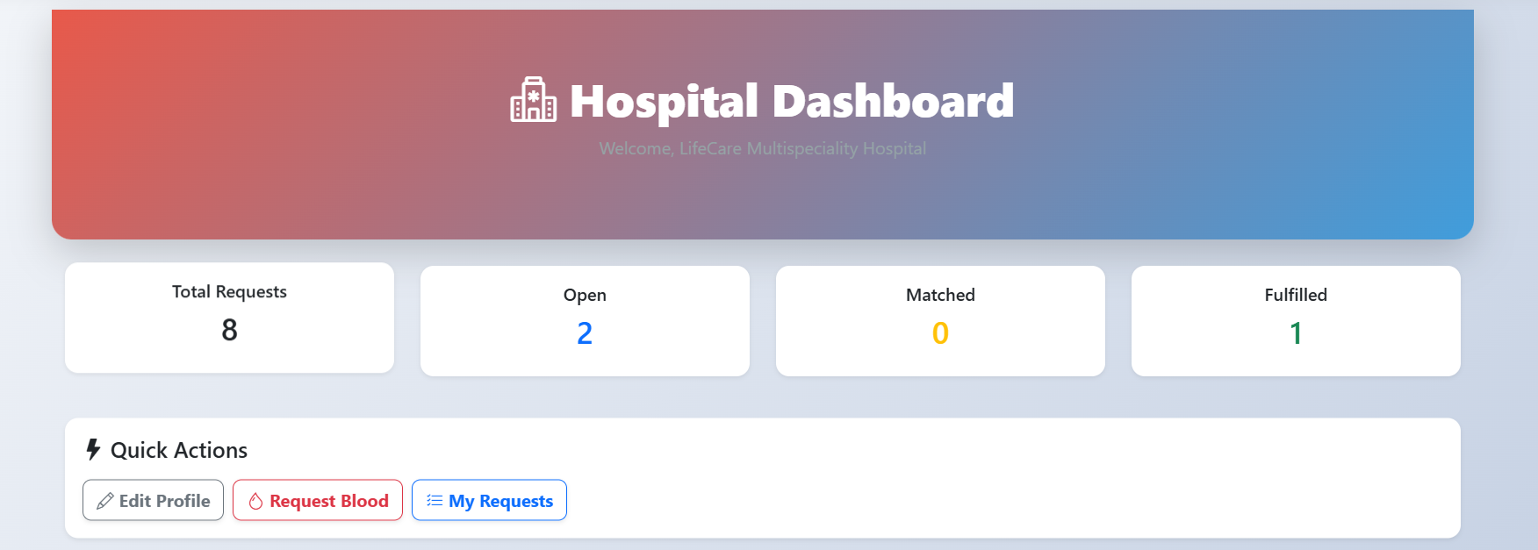
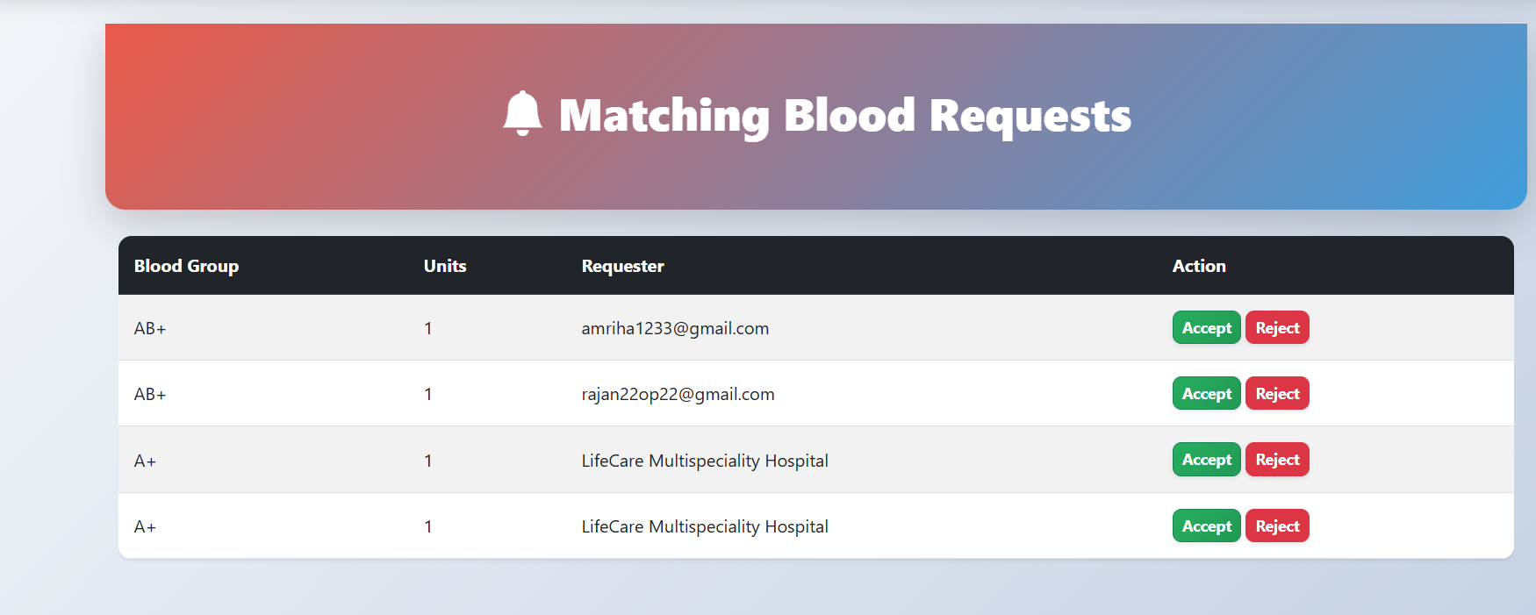

Slide 13
CONCLUSION & FUTURE WORK :
CONCLUSION
The system simplifies the process of finding blood donors
It reduces time delay during emergency situations
OBDMS ensures secure, request-based blood donation
Improves donor–hospital coordination
FUTURE WORK
Emergency SMS & mobile app integration
Distance-based & AI-based donor matching

Slide 14
REFERENCES :
https://getbootstrap.com
https://www.python.org
https://docs.djangoproject.com
https://www.researchgate.net/
Notes:
This slide, The speaker will talk about the content that we will be covering in this session as follows:
Introduction
Importance of UI/UX in industry
History and Definitions of UI and UX
Key Differences between UI/UX
Use Cases
Significance in Web Development
Use Cases
Visual Design Principles
Design process
Color theory and psychology
Typography and readability
Layout and Spacing
Responsive design basics
Usability and Accessibility
Usability Aspects
Web Content Accessibility Guidelines (WCAG)
Inclusive design practices
Consistency
User Experience
User-Centered Design
User research methods
Interactive Elements and Feedback
Mini Case Study
Discussing a popular UI/UX design
Hands-On
Introduction to Figma for UI/UX design

